Slide 1
Urban Resilience Assessment through Data Analytics: Predicting Carbon Emission Value for Future
Presented By: Muskan Patel (3110495)
Under Supervision of Aqeel Kazmi

Slide 2
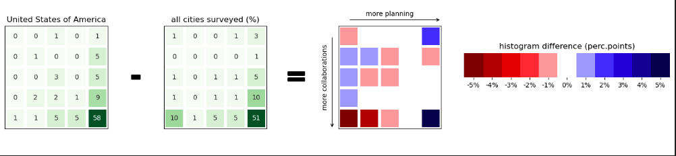
Concept & Objective
Objective:
Utilize data analytics to improve urban resilience and preparedness.
Predict future carbon emissions to guide sustainable urban planning.

Slide 3
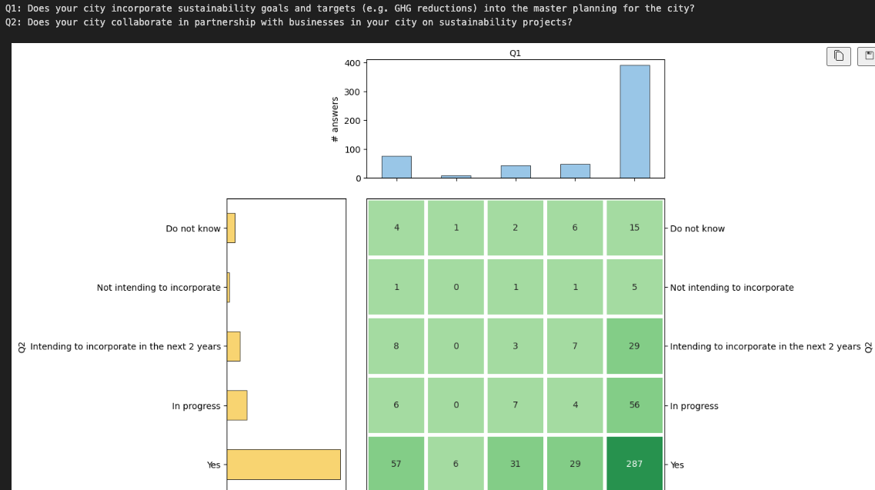
Need for Enhancing Urban Resilience in Modern Cities
BACKGROUND
Increasing Urbanization
Natural Disasters
Climate Change
Resource Constraints
Economic Importance
Technology Dependency
Public Health
Prediction of Carbon Emission in Future
Increasing Levels
Transportation Sector
Industrial Growth
Energy Use
Forest Loss
Regulatory Shifts
Climate Change
Health Hazards

Slide 4
Technology Used:
DATASET USED:
Jupyter Notebook - Python: For data analytics and machine learning
Libraries Used: NumPy, Pandas, Scikit-Learn
PHP - Frontend: For web application and user interface
MySQL - Database: For data storage and retrieval
CITIES DISCLOSING (2020, 2019,2018)
CITIES RESPONSES (2020,2019,2018)
CITIES QUESTIONNAIRES (2020,2019,2018)
Data.csv for CO2 emission
WHERE TO FIND DATASET:
https://data.cdp.net

Slide 5
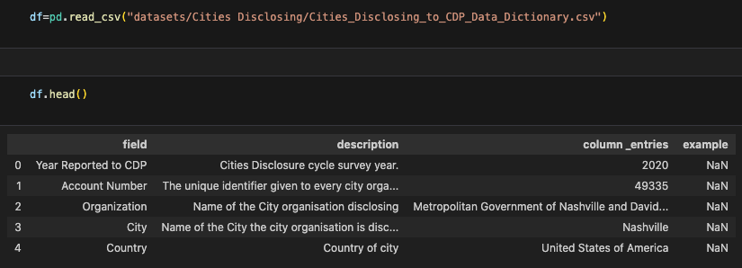
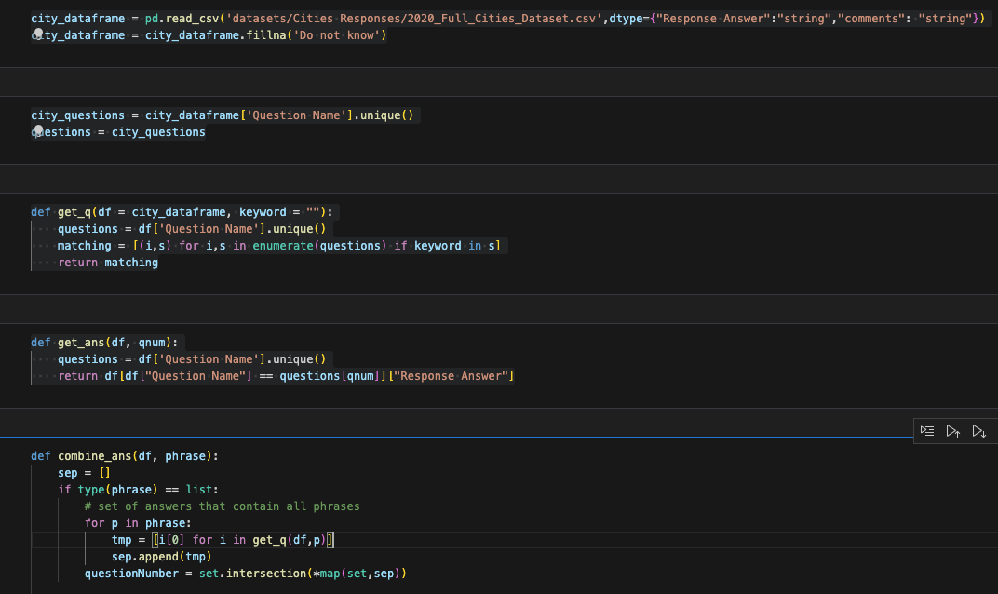
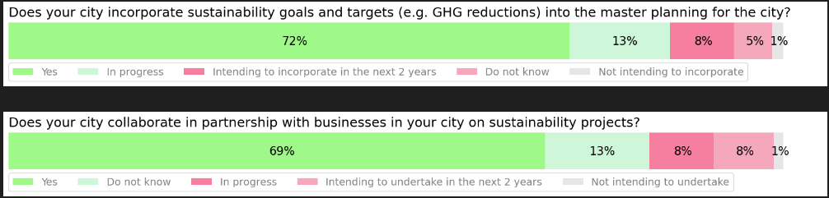
IMPLEMENTATION
DATASET
CLEANING & PRE-PROCESSING
DATA ANALYSIS & VISUALIZATION

Slide 6
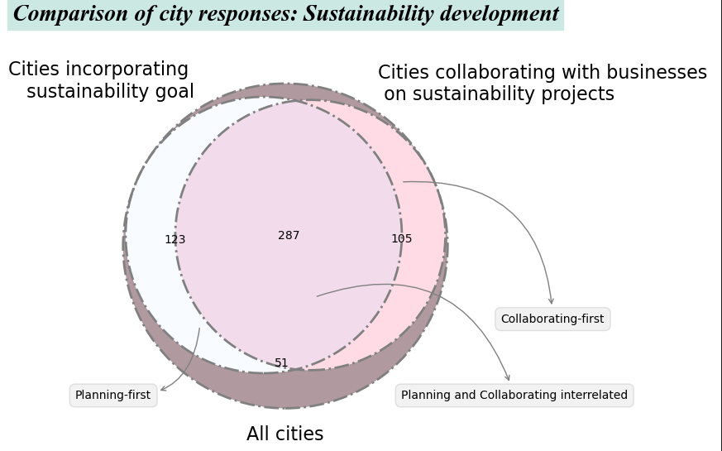

Slide 7
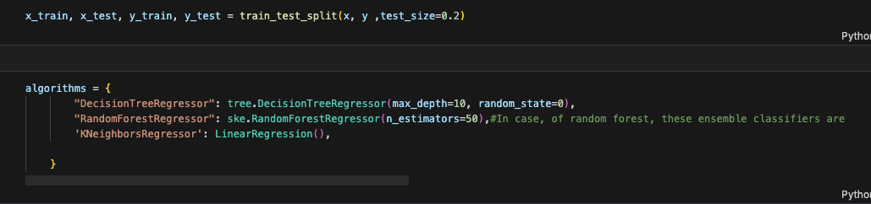
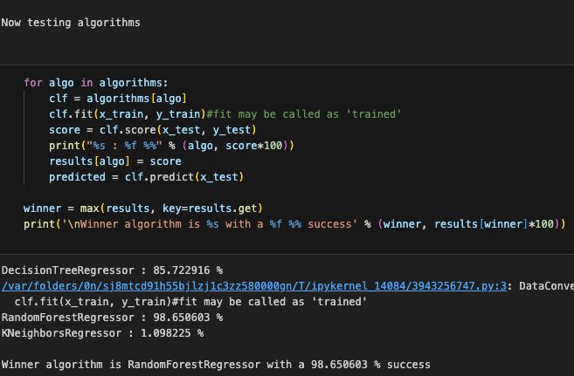
MACHINE LEARNING
99.20%

Slide 8
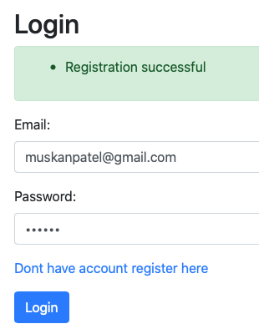
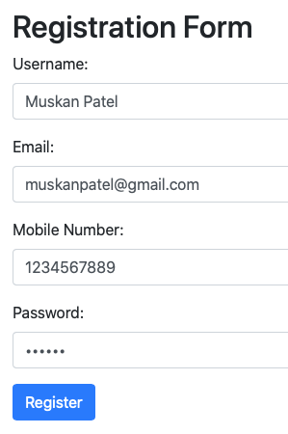
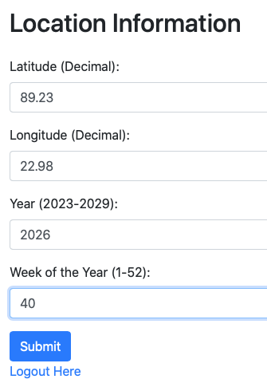

Slide 9
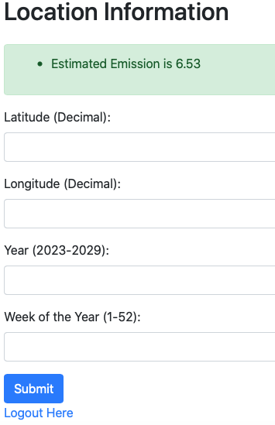
RESULT & FUTURE WORKS
Extend prediction models to other KPIs like Air Quality, Energy Use, Waste Recycling, etc.
Identify sources responsible for KPIs to pinpoint root causes for targeted action.
Implement preventive measures to mitigate urbanization problems and promote sustainability.

Slide 10
Thank You !

